Slide 1
TUGAS Kalkulus
Galih Anggoro Prasetya
Teknik Informatika
22205018

Slide 2
Metode Euler

Slide 3
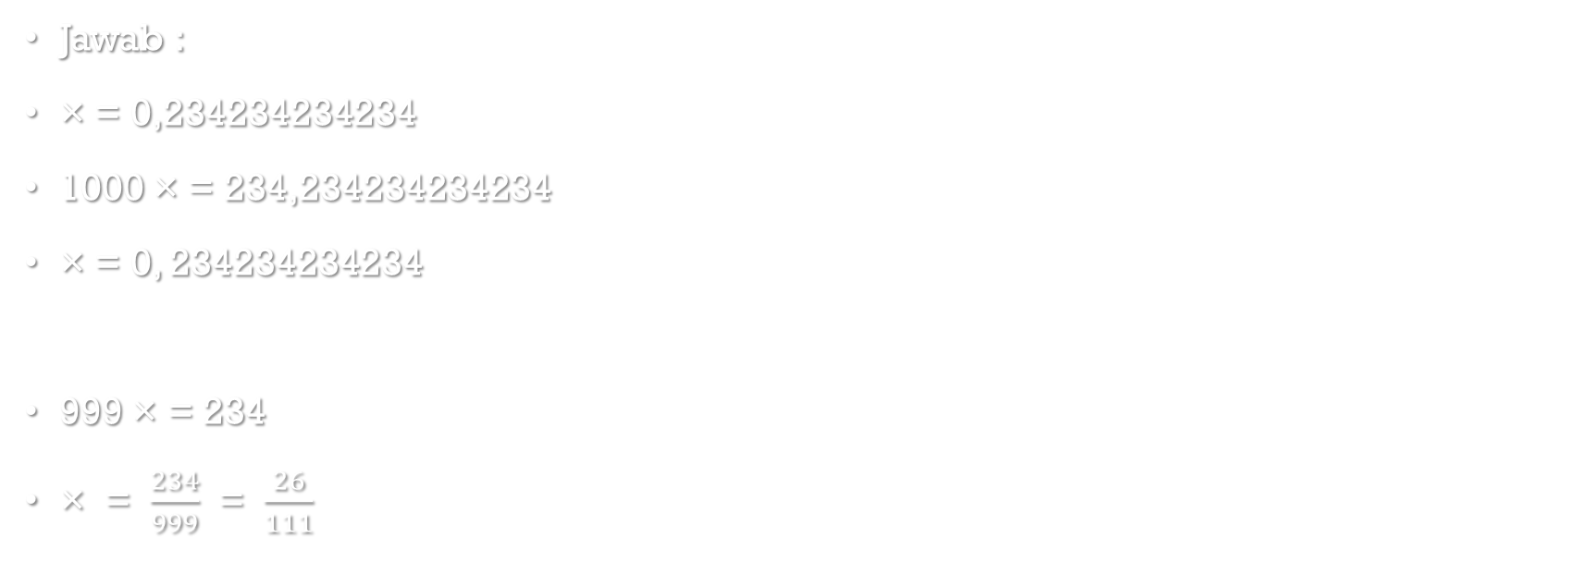
2. 0,234234234234
Jawab :
× = 0,234234234234
1000 × = 234,234234234234
× = 0, 234234234234
999 × = 234
× = $\frac{234}{999}$ = $\frac{26}{111}$

Slide 4
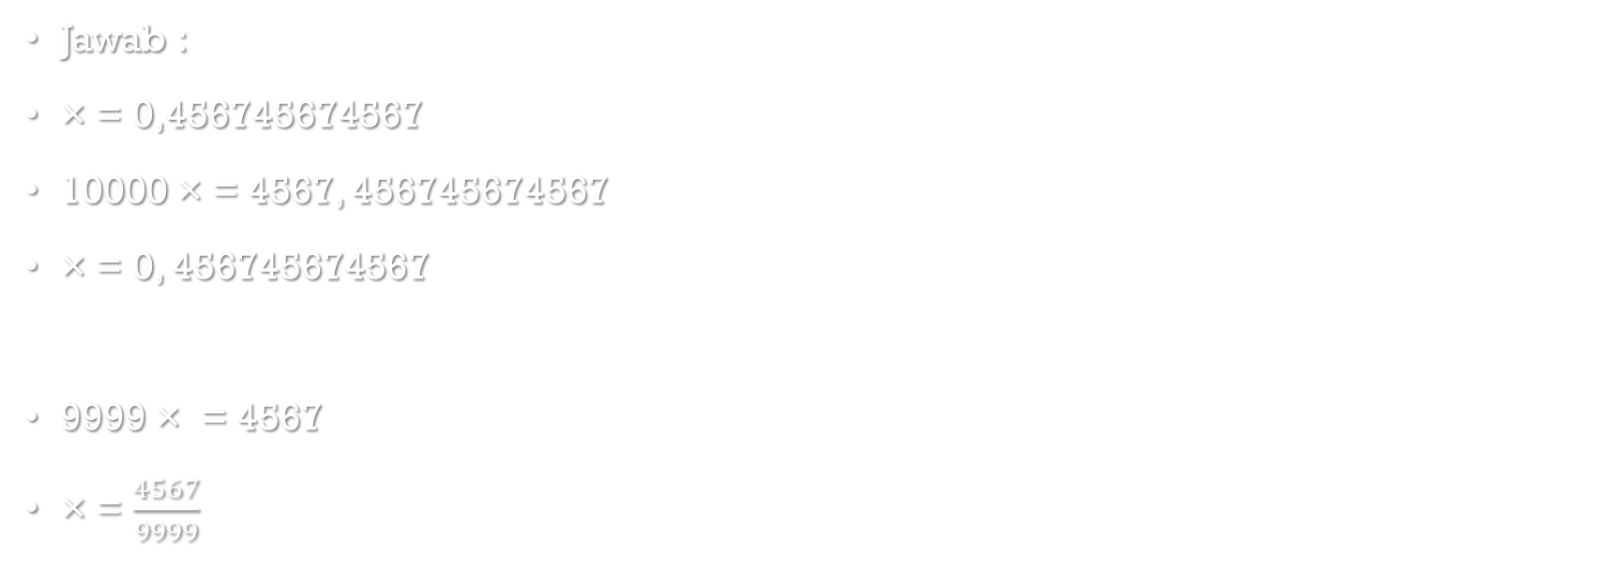
3. 0,456745674567
Jawab :
× = 0,456745674567
10000 × = 4567, 456745674567
× = 0, 456745674567
9999 × = 4567
× = $\frac{4567}{9999}$

Slide 5
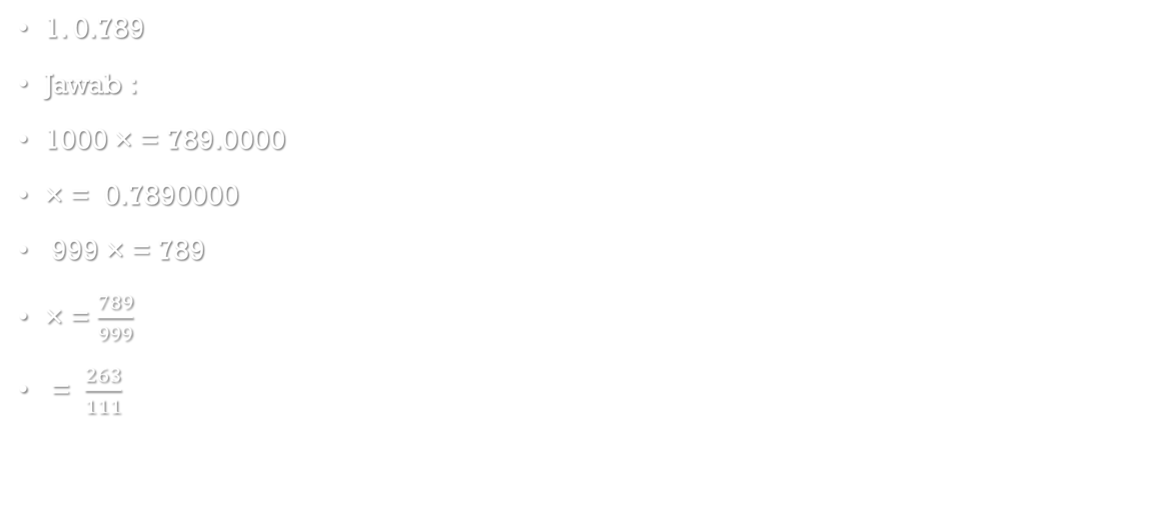
4. 0,789765476547654
1. 0.789
Jawab :
1000 × = 789.0000
× = 0.7890000
999 × = 789
× = $\frac{789}{999}$
= $\frac{263}{111}$

Slide 6
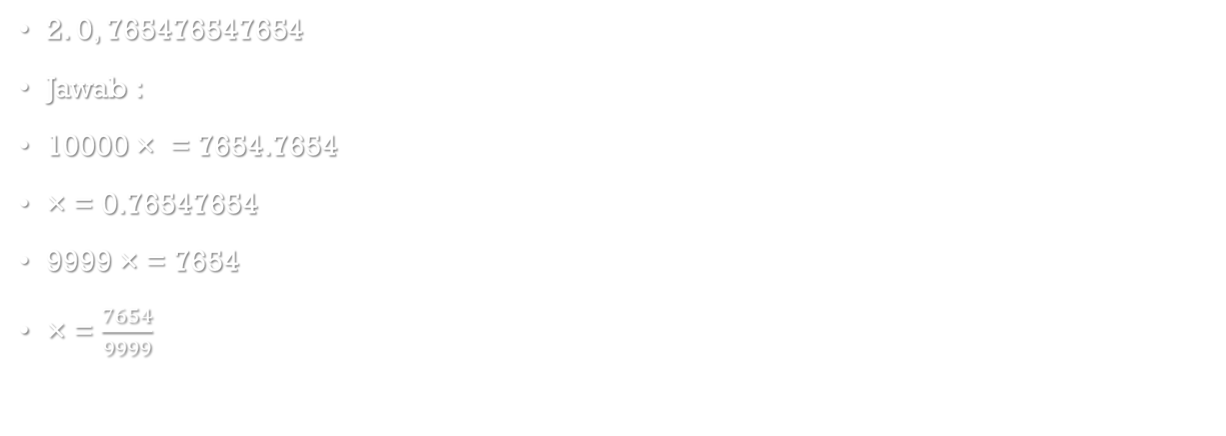
4. 0,789765476547654
2. 0, 765476547654
Jawab :
10000 × = 7654.7654
× = 0.76547654
9999 × = 7654
× = $\frac{7654}{9999}$

Slide 7
Deret Waktu Tak Hingga

Slide 8
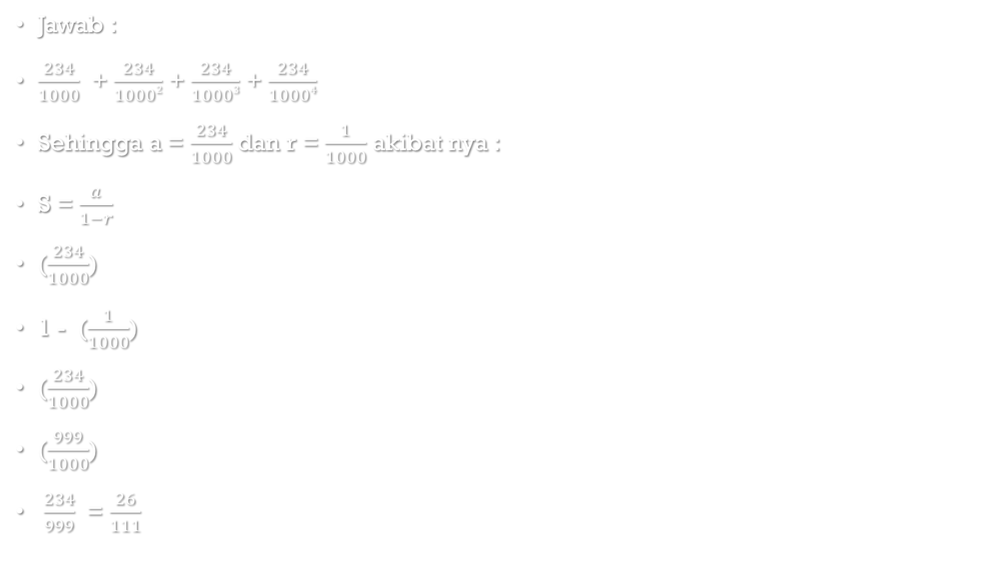
2. 0,234234234234
Jawab :
$\frac{234}{1000}$ + $\frac{234}{10002}$ + $\frac{234}{10003}$ + $\frac{234}{10004}$
Sehingga a = $\frac{234}{1000}$ dan r = $\frac{1}{1000}$ akibat nya :
S = $\frac{a}{1−r}$
($\frac{234}{1000}$)
1 - ($\frac{1}{1000}$)
($\frac{234}{1000}$)
($\frac{999}{1000}$)
$\frac{234}{999}$ = $\frac{26}{111}$

Slide 9
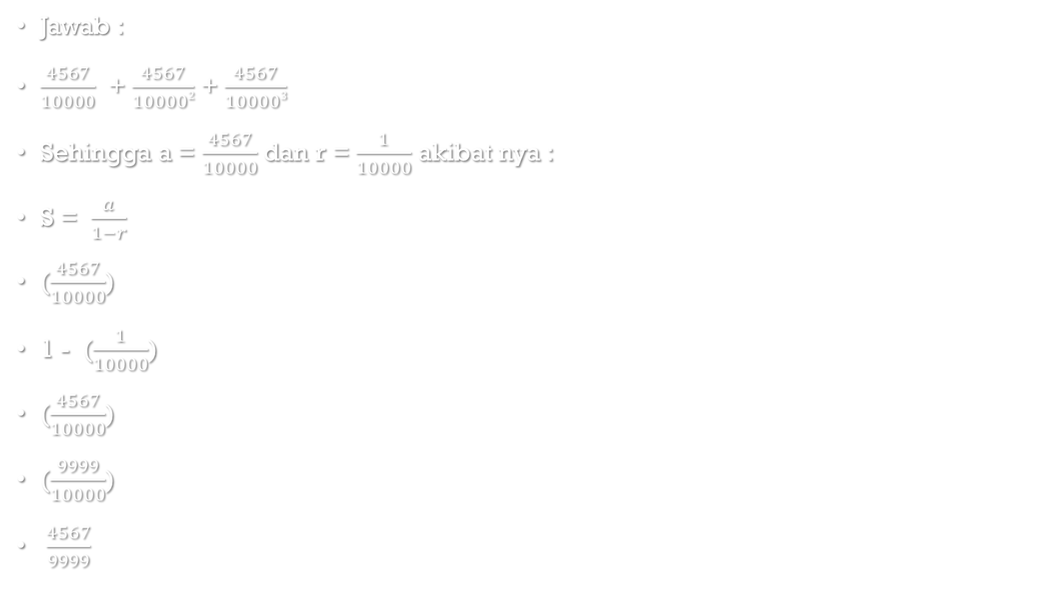
3. 0,456745674567
Jawab :
$\frac{4567}{10000}$ + $\frac{4567}{100002}$ + $\frac{4567}{100003}$
Sehingga a = $\frac{4567}{10000}$ dan r = $\frac{1}{10000}$ akibat nya :
S = $\frac{a}{1−r}$
($\frac{4567}{10000}$)
1 - ($\frac{1}{10000}$)
($\frac{4567}{10000}$)
($\frac{9999}{10000}$)
$\frac{4567}{9999}$

Slide 10
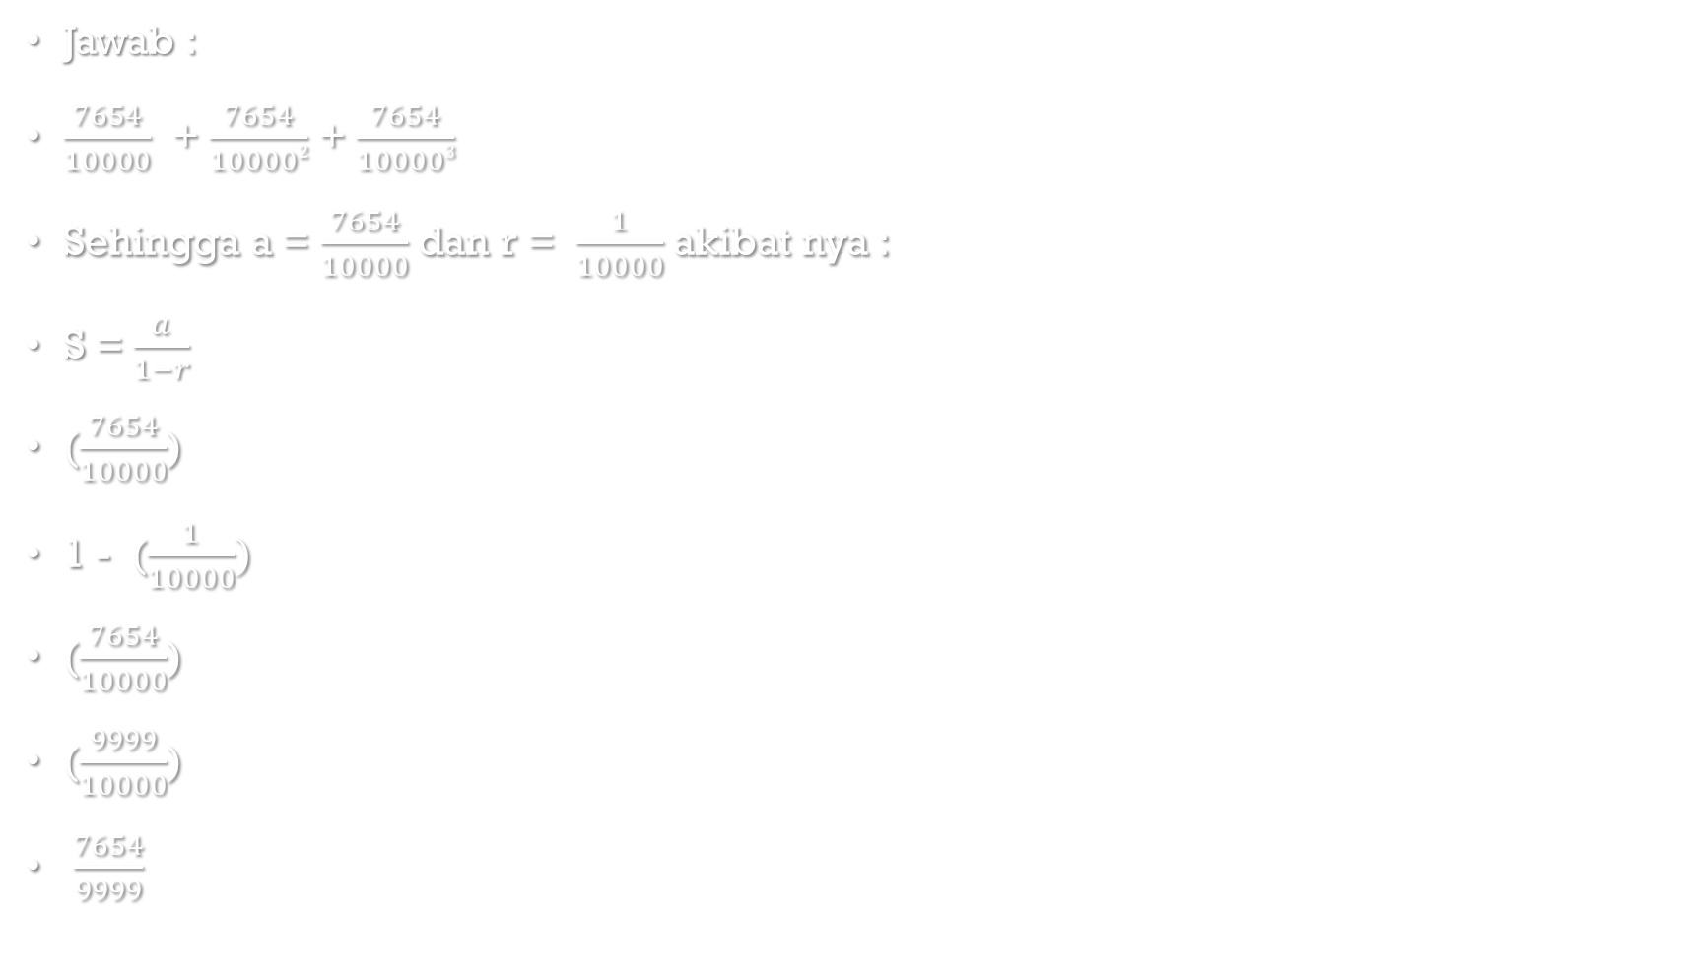
4. 0,789765476547654
Jawab :
$\frac{7654}{10000}$ + $\frac{7654}{100002}$ + $\frac{7654}{100003}$
Sehingga a = $\frac{7654}{10000}$ dan r = $\frac{1}{10000}$ akibat nya :
S = $\frac{a}{1−r}$
($\frac{7654}{10000}$)
1 - ($\frac{1}{10000})$
($\frac{7654}{10000}$)
($\frac{9999}{10000}$)
$\frac{7654}{9999}$

Slide 11
Selesai

